Slide 1
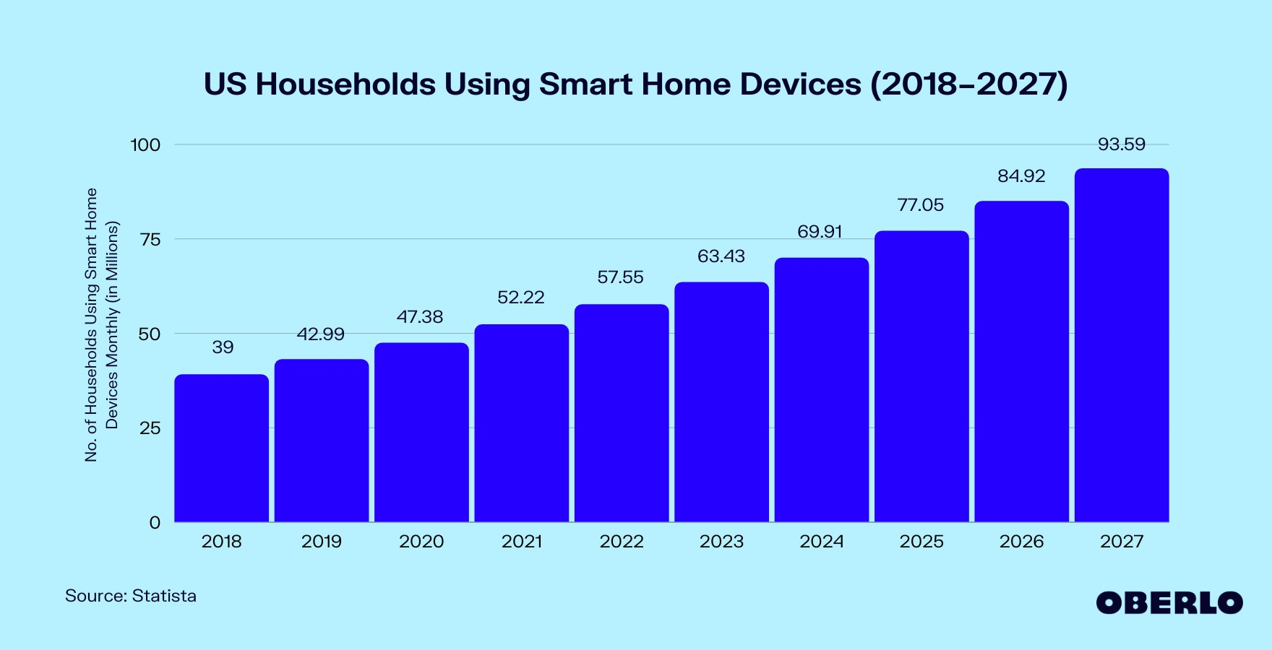




Alerting Users to Phishing Threats: A Comprehensive Evaluation of Warning Techniques
Bachelor Thesis by Yunus Emre Yavuz
Date: 25.06.2024
Examiner: Univ.-Prof. Dr. Florian Alt
Supervisors: Felix Dietz, M.Sc.; Dr. Verena Distler
Icons: fontawesome.com
Introduction
Related Work
Design
Results
Discussion
Conclusion

Slide 2
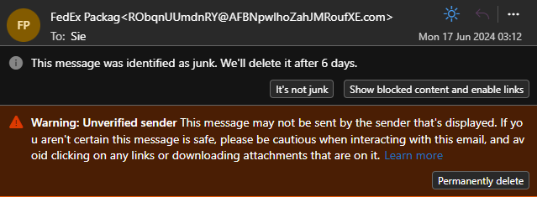


Major Threat:
Phishing
waRNING Alerts
Phishing causing financial losses and trust issues
Crucial defense mechanism against phishing attacks
Introduction
Related Work
Design
Results
Discussion
Conclusion

Slide 3
What I have Done
Major Threat:
Phishing
wARNING Alerts
Designed and implemented phishing warnings
Conducted a mixed-methods study (N=16)
Collected Eye Tracking Data + Qualitative Feedback
Phishing causing financial losses and trust issues
Crucial defense mechanism against phishing attacks
Introduction
Related Work
Design
Results
Discussion
Conclusion

Slide 4

Research Questions
What I have Done
Major Threat: Phishing
Phishing Alerts
wARNING Alerts
Major Threat:
Phishing
RQ1: How do users' perceptions differ regarding various phishing warnings, and which type is seen as the most effective?
How do users perceive the usefulness of each warning type?
Which warning design do users prefer and why?
RQ2: What common gaze patterns emerge when users scan email content, and how can these patterns aid in strategically placing phishing warnings to maximize attention?
Designed and implemented phishing warnings
Conducted a mixed-methods user study (N=16)
Collected Eye Tracking Data + Qualitative Feedback
Phishing causing financial losses and trust issues
Crucial defense mechanism against phishing attacks
Phishing causing financial losses and trust issues
Crucial defense mechanism against phishing attacks
Introduction
Related Work
Design
Results
Discussion
Conclusion

Slide 5
Research Questions
What I have Done
What I have Done
RQ1: How do users' perceptions differ regarding various phishing warnings, and which type is seen as the most effective?
How do users perceive the usefulness of each warning type?
Which warning design do users prefer and why?
RQ2: What common gaze patterns emerge when users scan email content, and how can these patterns aid in strategically placing phishing warnings to maximize attention?
Designed and implemented phishing warnings
Conducted a mixed-methods user study (N=16)
Collected Eye Tracking Data + Qualitative Feedback
Designed and implemented phishing warnings
Conducted a mixed-methods study (N=16)
Collected Eye Tracking Data + Qualitative Feedback
Introduction
Related Work
Design
Results
Discussion
Conclusion

Slide 6


Related Work
Combatting Phishing
Human Factors
Technical Strategies & User Education
Why does Phishing work?
6
Introduction
Related Work
Design
Results
Discussion
Conclusion

Slide 7
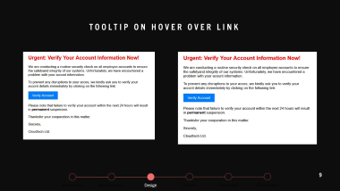
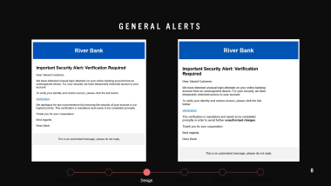
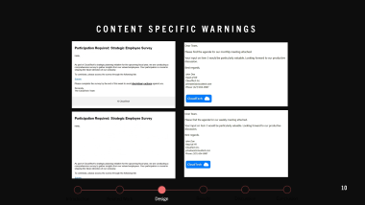
Warning Designs
7
Introduction
Related Work
Design
Results
Discussion
Conclusion

Slide 8
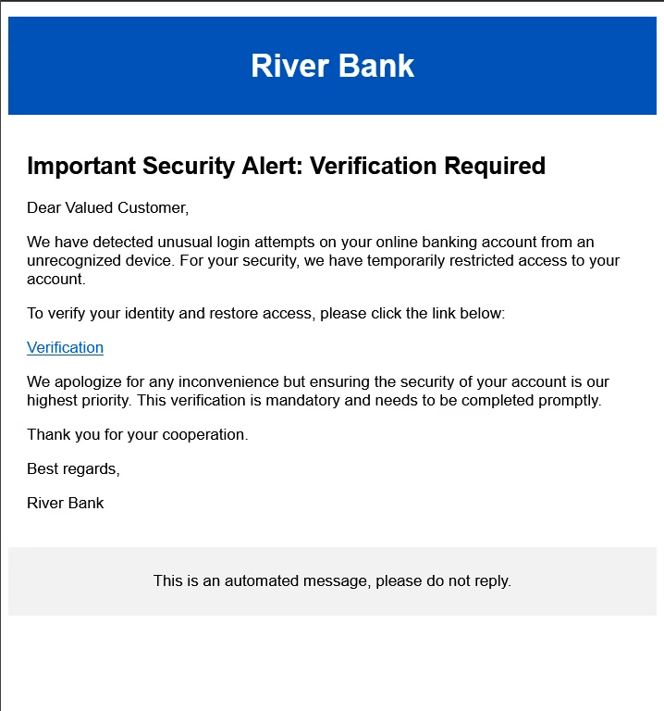
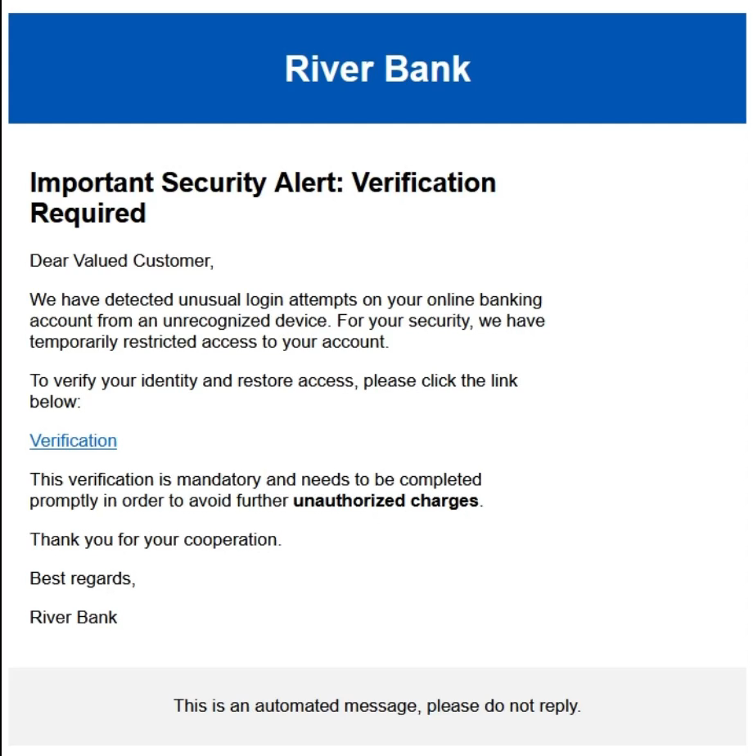
General Alerts
8
Introduction
Related Work
Design
Results
Discussion
Conclusion

Slide 9
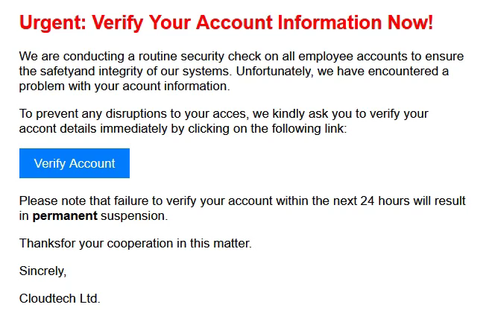

Tooltip on Hover Over Link
9
Introduction
Related Work
Design
Results
Discussion
Conclusion

Slide 10
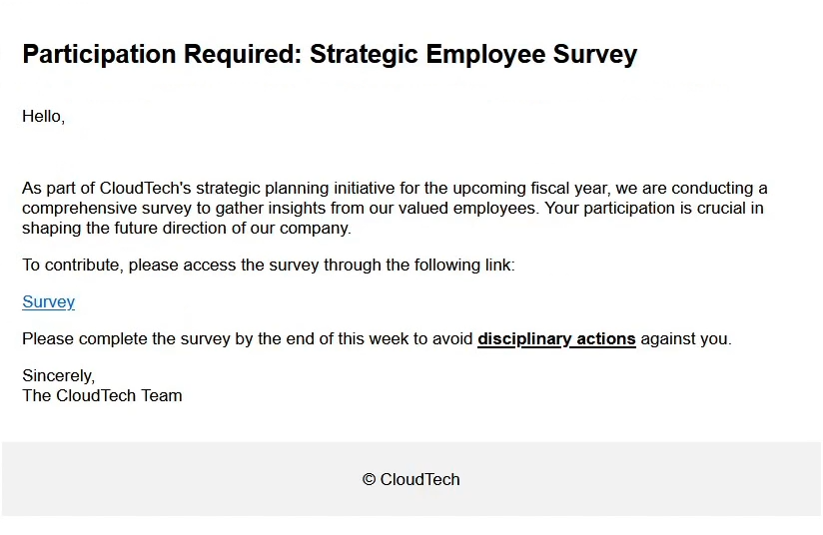
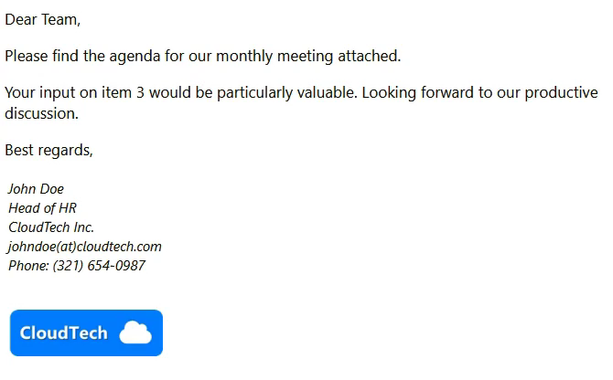
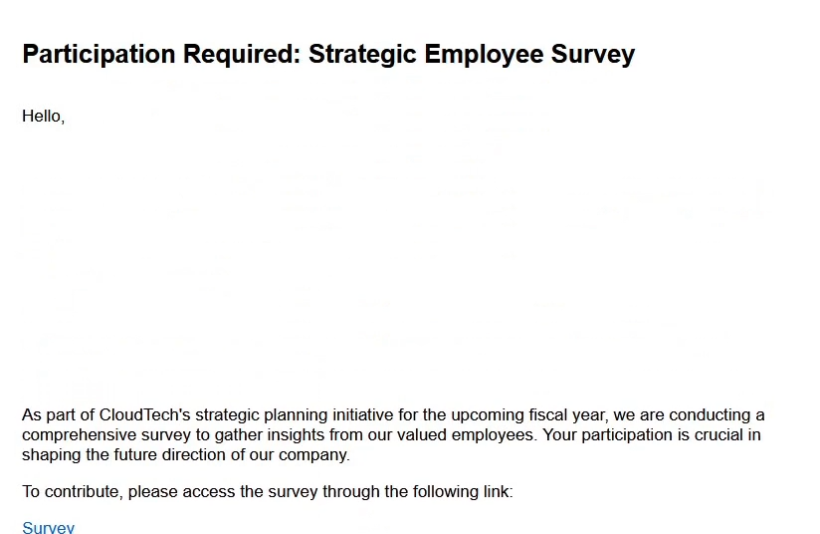
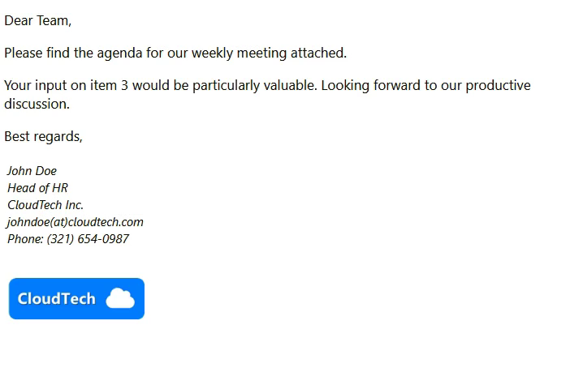
Content Specific Warnings
10
Introduction
Related Work
Design
Results
Discussion
Conclusion

Slide 11
Demographics |  | Total (N=16) | %
Age | 20 - 29 | 13 | 81,25
 | 30 - 39 | 2 | 12,5
 | 40+ | 1 | 6,25
Gender | Male | 10 | 62,5
 | Female | 6 | 37,5
 | Non-binary | 0 | 0
 | Prefer not to tell | 0 | 0
Education | Doctorate degree | 1 | 6,25
 | Graduate degree | 2 | 12,5
 | Undergraduate degree | 9 | 56,25
 | High school diploma | 4 | 25
 | Secondary education | 0 | 0
 | Other | 0 | 0
Profession | Student | 13 | 87,5
 | Research Assistant | 1 | 6,25
 | Retiree | 1 | 6,25
11
Introduction
Related Work
Design
Results
Discussion
Conclusion

Slide 12
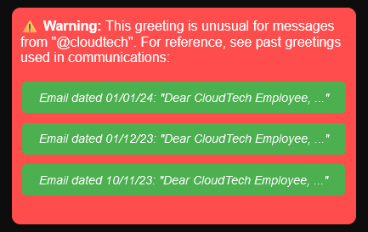


User Feedback
Attention grabbing
Details are appreciated for their educational value
Legibility & Animations
Side-placed Warnings
12
Introduction
Related Work
Design
Results
Discussion
Conclusion

Slide 13
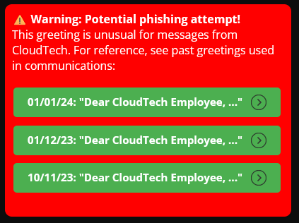
Incorporating User Feedback
Placement
+ Center Placed
- Banners on the Side
13
Introduction
Related Work
Design
Results
Discussion
Conclusion

Slide 14
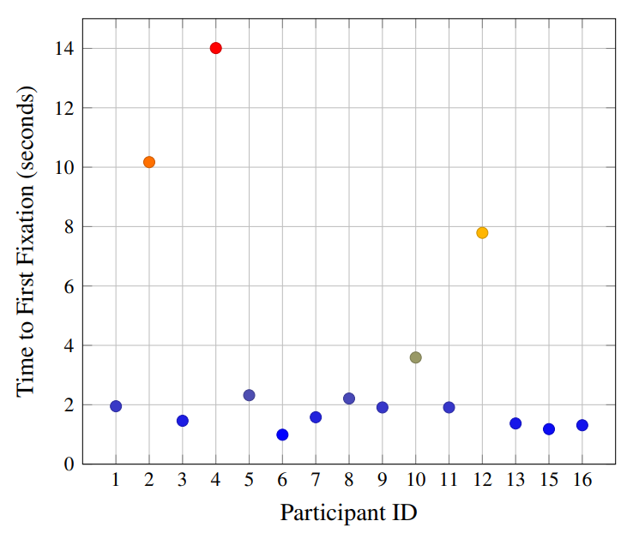


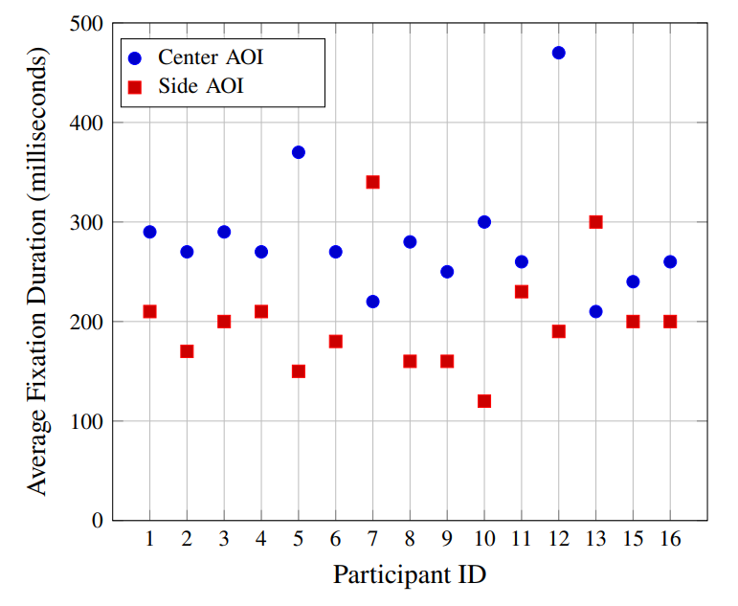
Eye Tracking Results
Hypothesis 1: Delayed slide-in animations draw more attention → no significant difference observed
Hypothesis 2: Side-placed warnings will be noticed later → Median TtFF ~2s (Comparision Top-placed: ~1s)
Hypothesis 3: Body-integrated warnings will hold user attention for longer periods → Supported by a consistently longer Avg. Fixation Duration
Time to First Fixation for Side-placed Warnings
Avg. Fixation Duration: Comparing Center and Side AOI
14
Introduction
Related Work
Design
Results
Discussion
Conclusion

Slide 15
Emerging Themes & Best Practices
Clarity
Readability: Clear, legible text with contrasting background
Attention-Grabbing
Contextual Information
Contextual Details: Explain why the email is flagged
Educational Value: Teach Users how to detect future attempts
Animation Balance: Capture attention, avoid sensory overload with moderate animations
Incorporating User Feedback
Continuous Testing: Regular user feedback and design adjustments
TrusT
User Confidence: Clear distinction of safe interactive elements
15
Introduction
Related Work
Design
Results
Discussion
Conclusion

Slide 16
RQ1: Users’ Perceptions: Most effective & Helpful Warning
General Preferences
Warning Type | User Feedback
Tooltip on Hover | Very positive; users felt it was very effective and helpful
Content-Specific | Positive; users appreciated their specificity and novelty
General Alerts | Less favorable; often overlooked, too generic
Visibility and Informativeness
Seamless Integration
Immediate Attention
Long-Term Recognition
16
Introduction
Related Work
Design
Results
Discussion
Conclusion

Slide 17
RQ2: Common Gaze Patterns and Optimal Warning Placement
Warning Placement
Summary
Peripheral Warnings: Noticed later and engaged with less.
Warnings in the center are engaged with more extensively.
Central Focus: Users naturally focus on the central area
→ Central placement for crucial warnings
17
Introduction
Related Work
Design
Results
Discussion
Conclusion

Slide 18

Limitations
Participant Diversity & Sample Size
Study SetuP
18
Introduction
Related Work
Design
Results
Discussion
Conclusion

Slide 19
Conclusion
19
Introduction
Related Work
Design
Results
Discussion
Conclusion

Slide 20



Key Takeaways
Visibility is Crucial: Immediate and central placement of warnings ensures they are noticed and acted upon.
Informative Warnings: Providing context and reasoning in warnings helps users understand and recognize threats.
User-Centric Design: Incorporate user feedback for continuous improvement.
Broader Testing Needed
20
Introduction
Related Work
Design
Results
Discussion
Conclusion

